Slide 1
Big Data Analysis on H1B Data using Hadoop
Ravi Sharma
S180010900169
S180254 Batch - Borivali West Branch

Slide 2
Project Description
To perform various data analysis and visualization operations on the given dataset.
The dataset consists of application data filled by the employers in order to obtain h1b visas for their employees.
On the given dataset we have performed various operations using Hadoop tools to gather the required information and facts.

Slide 3
Tools Used

Slide 4
Hadoop Distributed File System (HDFS)
The Hadoop Distributed File System (HDFS) is the primary data storage system used by Hadoop applications.
It employs a NameNode and DataNode architecture to implement a distributed file system that provides high-performance access to data across highly scalable Hadoop clusters.

Slide 5
Yet Another Resource Negotiator (YARN)
Apache Yarn – “Yet Another Resource Negotiator” is the resource management layer of Hadoop.
Yarn allows different data processing engines like graph processing, interactive processing, stream processing as well as batch processing to run and process data stored in HDFS.

Slide 6
MapReduce
MapReduce is a software framework for processing large datasets in a distributed fashion using several machines.
The core idea behind MapReduce is mapping our data set into a collection of <key, value> pairs and then reducing over all the pairs with the same key.

Slide 7
Hive
Apache Hive is an ETL and Data warehousing tool built on top of Hadoop.
It makes job easy for performing operations like:
Analysis of huge datasets
Ad-hoc Queries
Data encapsulation

Slide 8
Pig
Pig consists of a high-level language to express data analysis programs, along with the infrastructure to evaluate these programs.
The Pig Latin language is a scripting language that allows users to illustrate the way in which data flow from one or more inputs must be read and processed, and the location in which must be stored.

Slide 9
Sqoop
Apache Sqoop is a tool that is extensively used to transfer large amounts of data from Hadoop to the relational database servers and vice-versa.
Sqoop can be used to import the various types of data from Oracle, MySQL and such other databases.

Slide 10
Questions

Slide 11
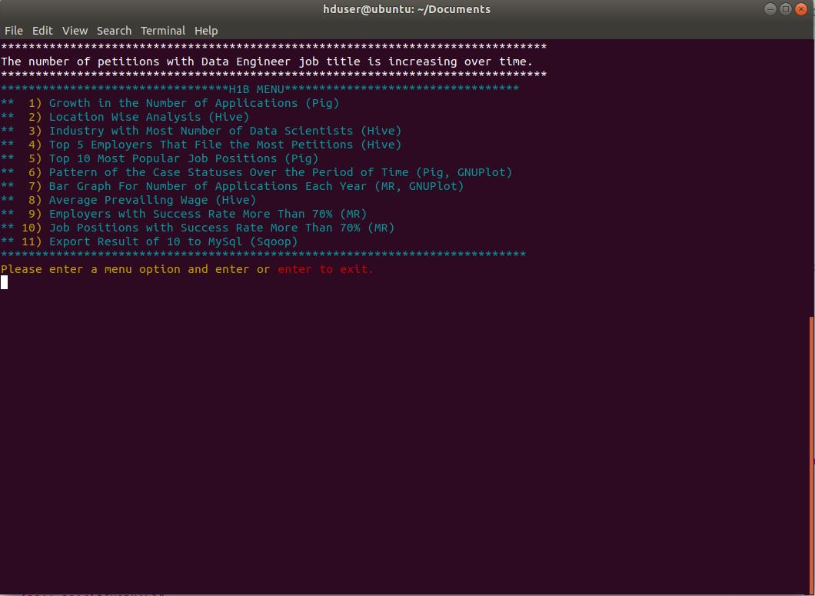
1a. Is the number of petitions with Data Engineer job title increasing over time?
Tool used: Pig

Slide 12
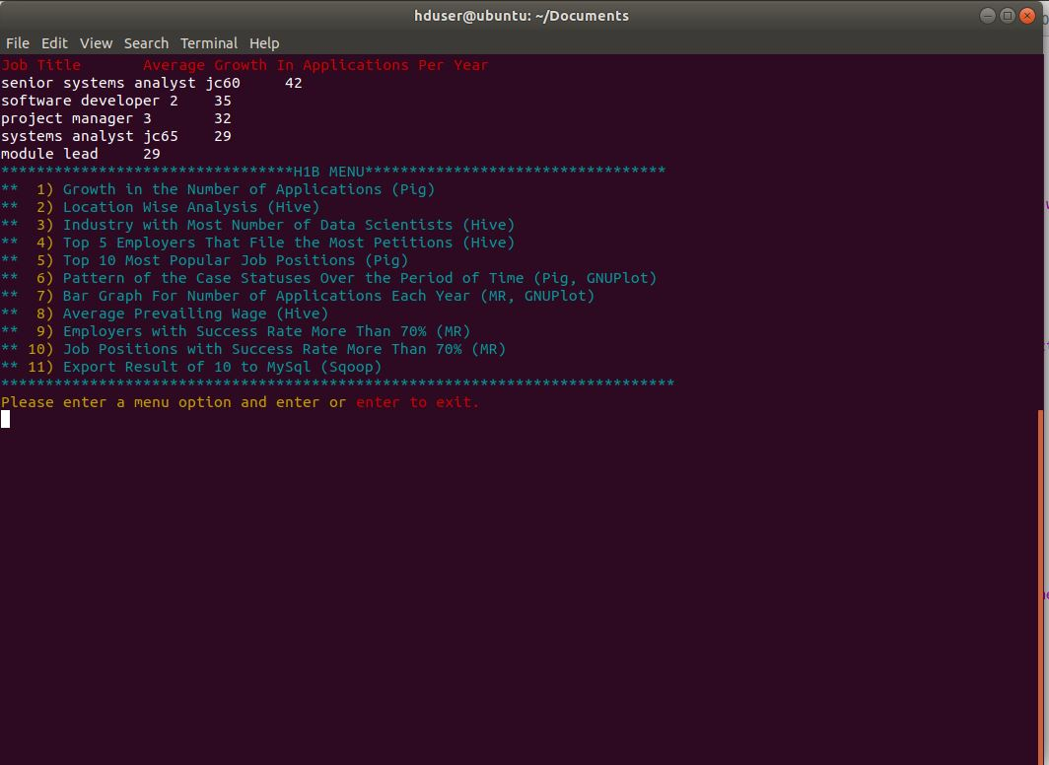
1b. Find top 5 job titles who are having highest avg growth in applications.
Tool used: Pig

Slide 13
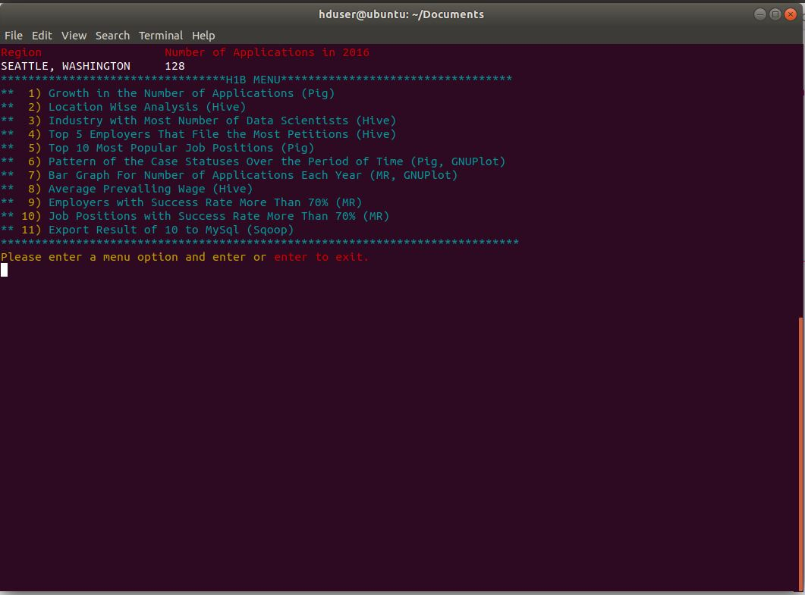
2a. Which part of the US has the most Data Engineer jobs for each year?
Tool used: Hive

Slide 14
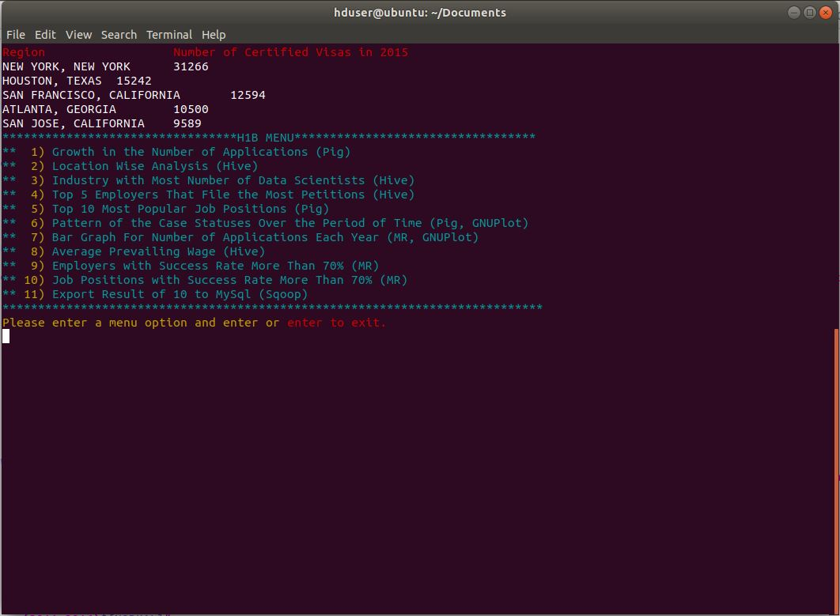
2b. Find top 5 locations in the US who have got certified visa for each year.
Tool used: Hive

Slide 15
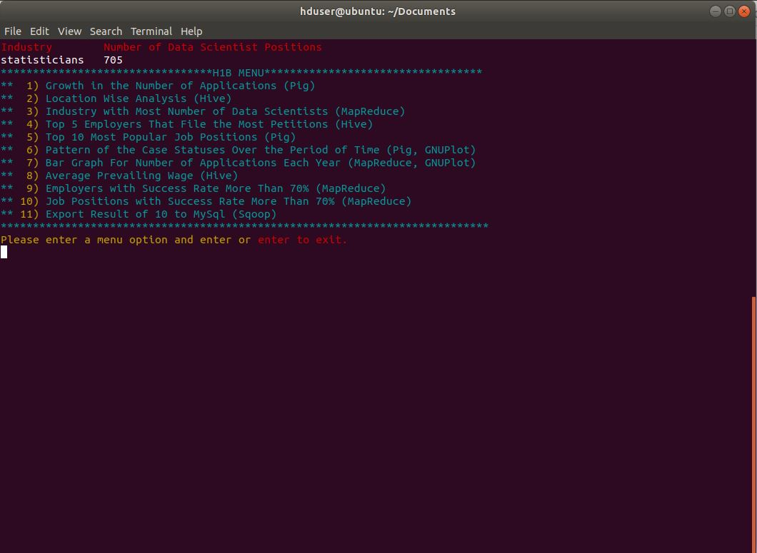
3. Which industry(SOC_NAME) has the most number of Data Scientist positions?
Tool used: MapReduce

Slide 16
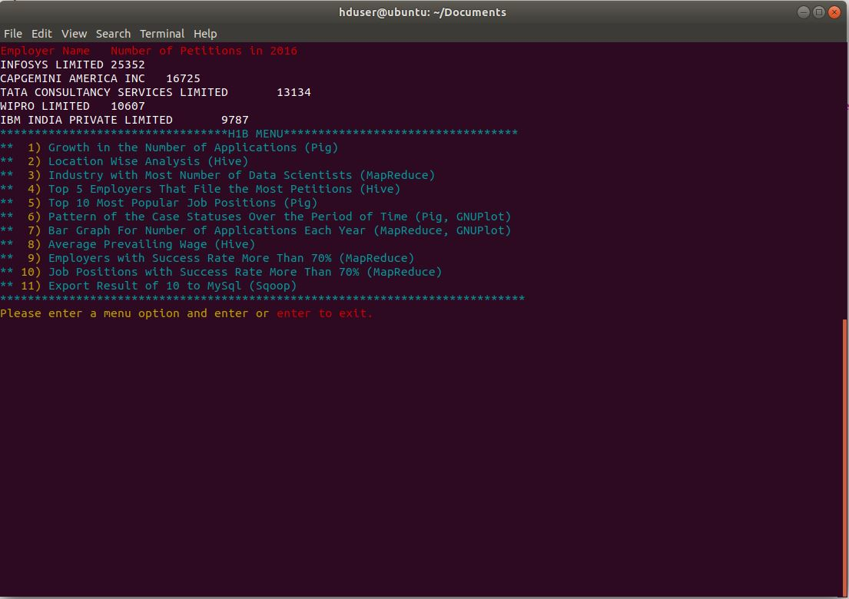
4. Which top 5 employers file the most petitions each year?
Tool used: Hive

Slide 17
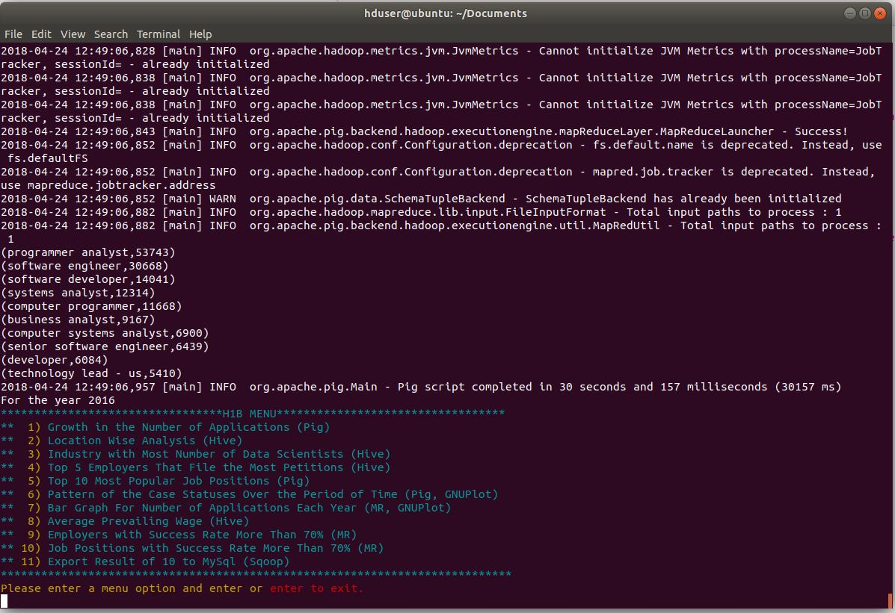
5. Find the most popular top 10 job positions for H1B visa applications for each year?
Tool used: Pig

Slide 18
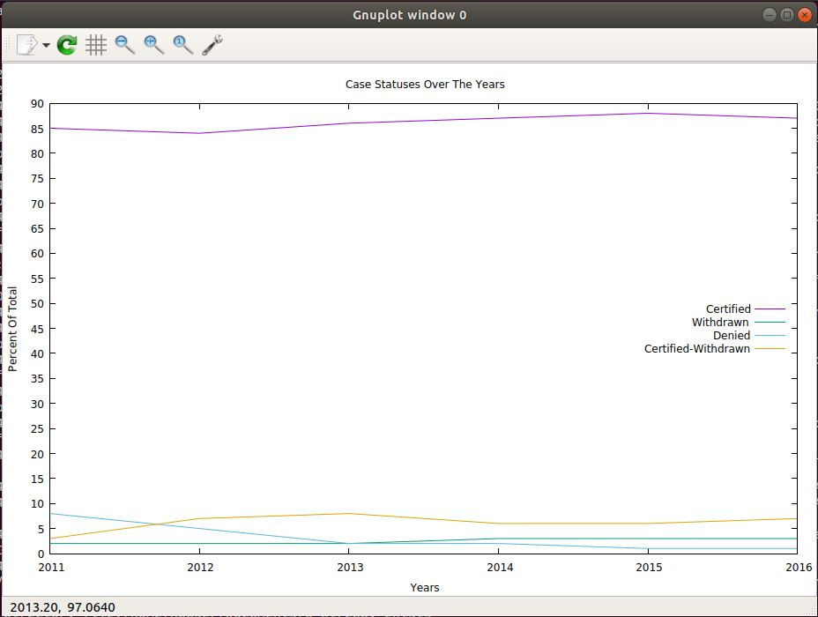
6. Find the percentage and the count of each case status on total applications for each year. Create a line graph depicting the pattern.
Tool used: Pig, GNUPlot

Slide 19
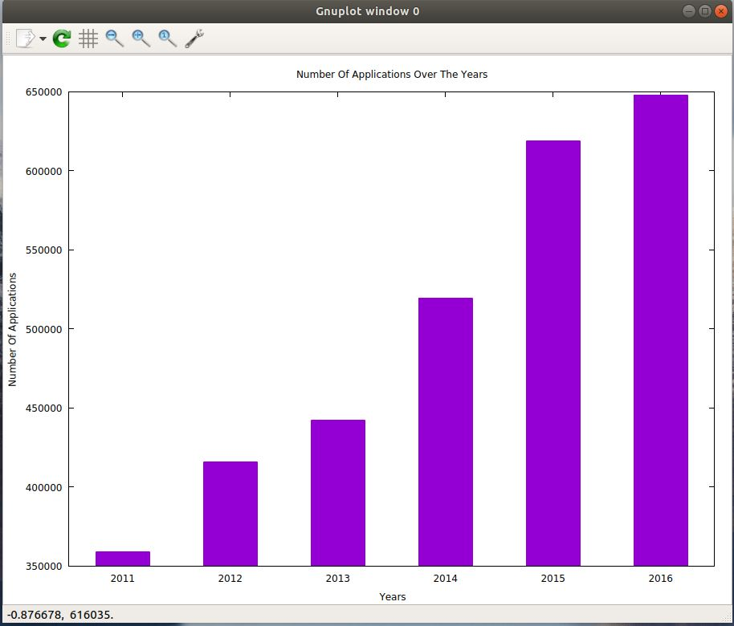
7. Create a bar graph to depict the number of applications for each year
Tool used: MapReduce, GNUPlot

Slide 20
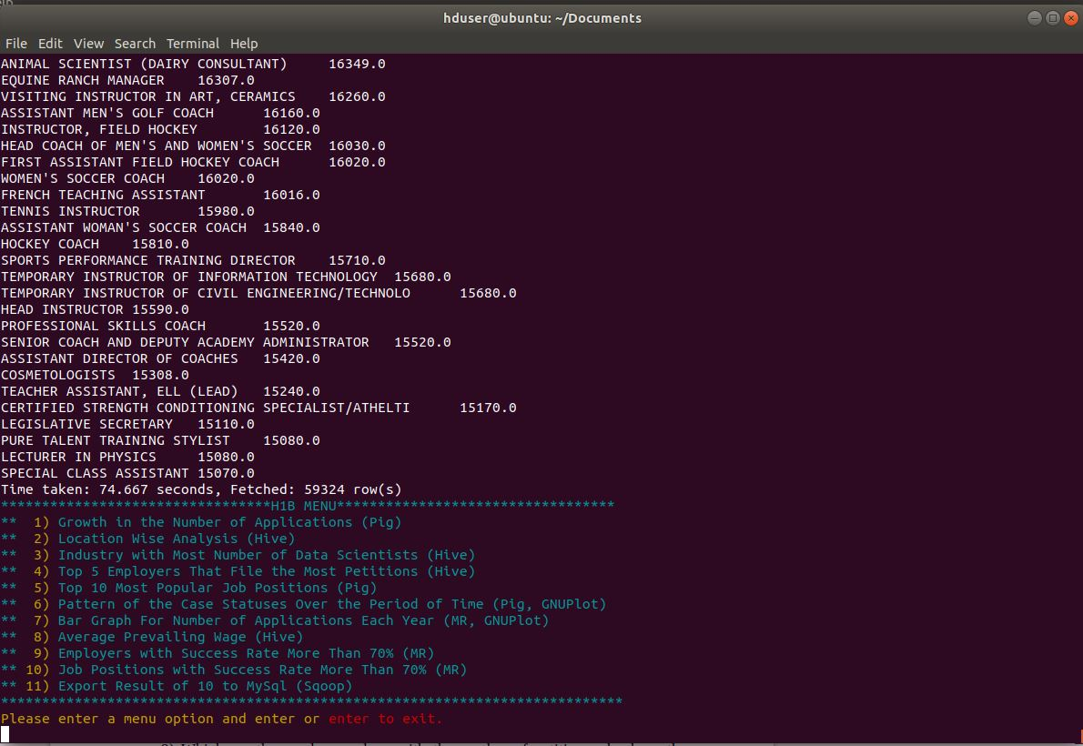
8. Find the average Prevailing Wage for each Job for each Year
Tool used: Hive

Slide 21
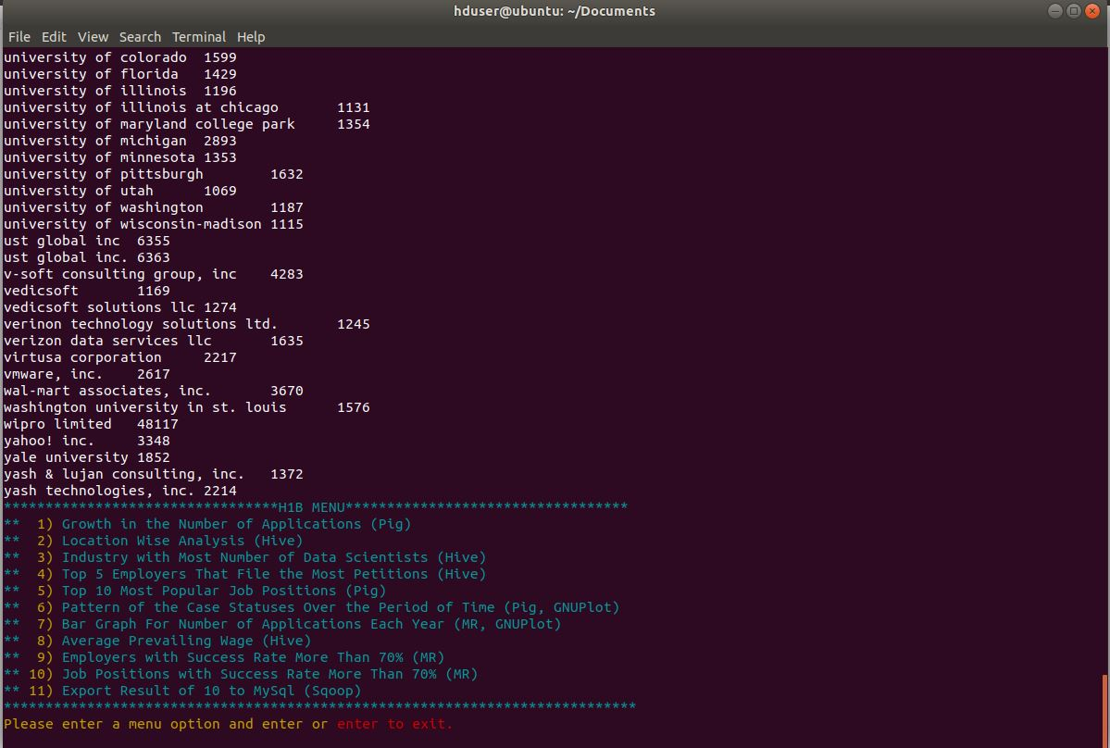
9. Which are the employers along with the number of petitions who have the success rate more than 70% in petitions.
Tool used: MapReduce

Slide 22
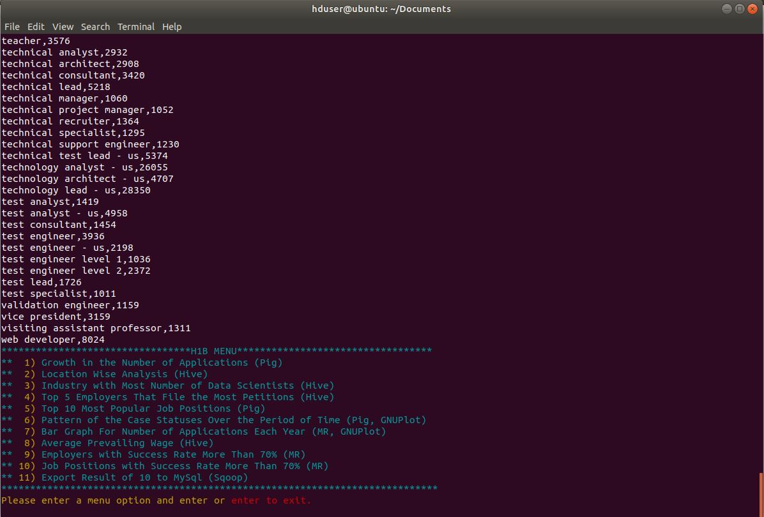
10. Which are the job positions along with the number of petitions which have the success rate more than 70% in petitions.
Tool used: MapReduce

Slide 23
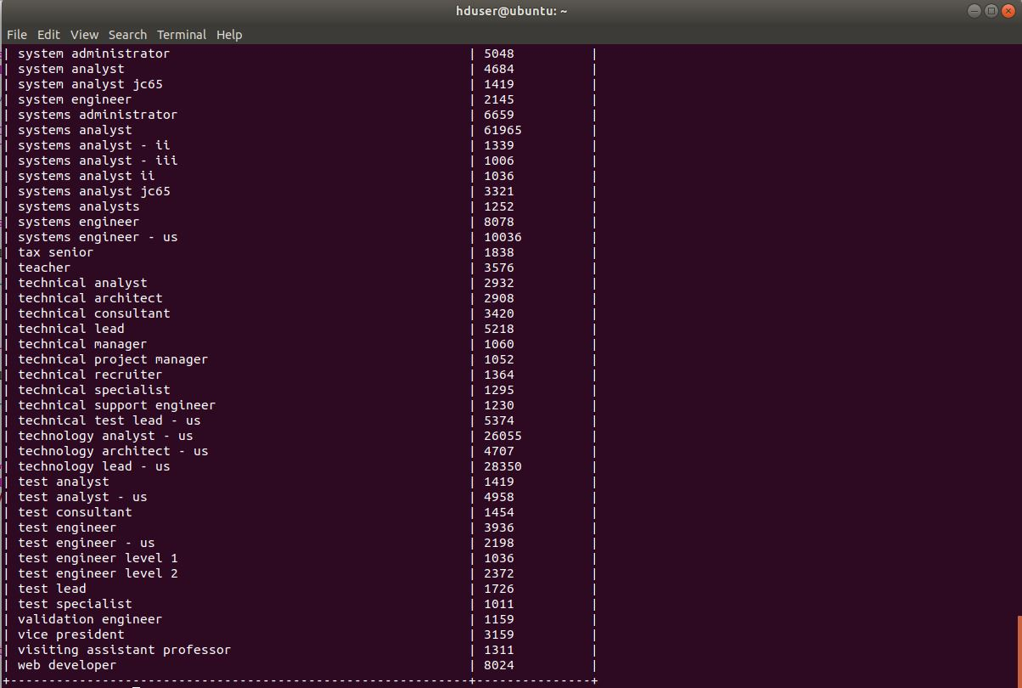
11. Export result for question no 10 to MySql database.
Tool used: MapReduce

Slide 24
Thank You.
Ravi Sharma
S180010900169
S180254 Batch - Borivali West Branch

